Slide 1
Importance of a Diverse Social Media Strategy
Rotary District 6200

Slide 2
Social Media Has Become Vital for Communicating Your Message Both Within Your Club But Also Within the Rotary Universe and Abroad

Slide 3
Most Important Platforms For Rotary Clubs

Slide 4
The following information is from
April 28, 2023

Slide 5
Demographics
Number of monthly active users: 2.963 billion
Largest age group: 25-34 (29.9%)
Gender: 44% female, 56% male
Time spent per day: 30 minutes
Facebook still remains the largest social platform among consumers and marketers.
Still, time spent on Facebook continues to fall as overall social media usage grows.
Following 2022’s social media demographic data, younger users continue to
flock to TikTok and Snapchat.

Slide 6
Demographics
Number of monthly active users: 2 billion (self-reported), other reports cite 1.35 billion
Largest age group: 18-24 (30.8%)
Gender: 48.2% female, 51.8% male (no data on other genders)
Time spent per day: 30.1 minutes
The platform’s growth remains steady after experiencing a boom period in recent years.
Instagram saw a small (but notable) flip in its age demographics. The platform boasts a slightly larger percentage of Gen Z users versus Millennials.
As far as social media age demographics go, Instagram maintains a firm hold on
both generations — these groups make up roughly two-thirds of their base.

Slide 7
Demographics
Number of members: 930 million
Largest age group: 30-39 (31%)
Gender: 43% female, 57% male (no data on other genders)
63% of LinkedIn users access the network weekly, 22% daily (in 2020)
Conventional wisdom might say that LinkedIn exclusively caters to an older audience. That said, Millennials dominate the platform.
LinkedIn continues to net record revenue and user growth. This growth was driven initially by the pandemic and continued during the shifting job market.
The platform’s demographic of high-earning B2B professionals makes LinkedIn a potential goldmine for ads.
Beyond the 200 million LinkedIn users in the US, the platform has a massive international reach.

Slide 8
Demographics
Number of monthly active users: 834.3 million, other reports cite 1+ billion
Largest age group: 18-24 (21%)
Gender: 54% female, 46% male (no data on other genders)
Time spent per day: 45.8 minutes
TikTok’s popularity and growth remain unprecedented. There are over 150 million active users on TikTok in the United States alone.
Not only is TikTok’s user base booming but also its daily activity. TikTok boasts the highest average time spent per day of any network.
The fact that the platform’s gender demographics are leveling out is also notable. Last year, the split was 61% female and 39% male. This signals TikTok’s status as a staple social app among the population at large.
As more and more brands get on board, we’re seeing influencers do the same.
TikTok is ramping up and “maturing” to meet the needs of its business-minded users.

Slide 9
Demographics
YouTube has 2.5 billion users, making up almost one-third of the entire internet. (Statista)
YouTube is the top video streaming app, and the average user spends 23.2 hours per month watching content. (App Annie)
Millennials trust YouTube more than any other generation. (HubSpot Blog Research)
56% of Gen Z, 54% of Millennials, 48% of Gen X, and 26% of Boomers say they discover new products most often on YouTube. (HubSpot Blog Research)
30.19% are the ages of 25-34, and 26.47% are the ages 18-24. (SimilarWeb)

Slide 10
How To Efficiently Post Across Several Platforms

Slide 11
Various Third Party Scheduler Platforms
Most Prices Vary Based Upon Linked Platforms Ranging $0-35

Slide 13
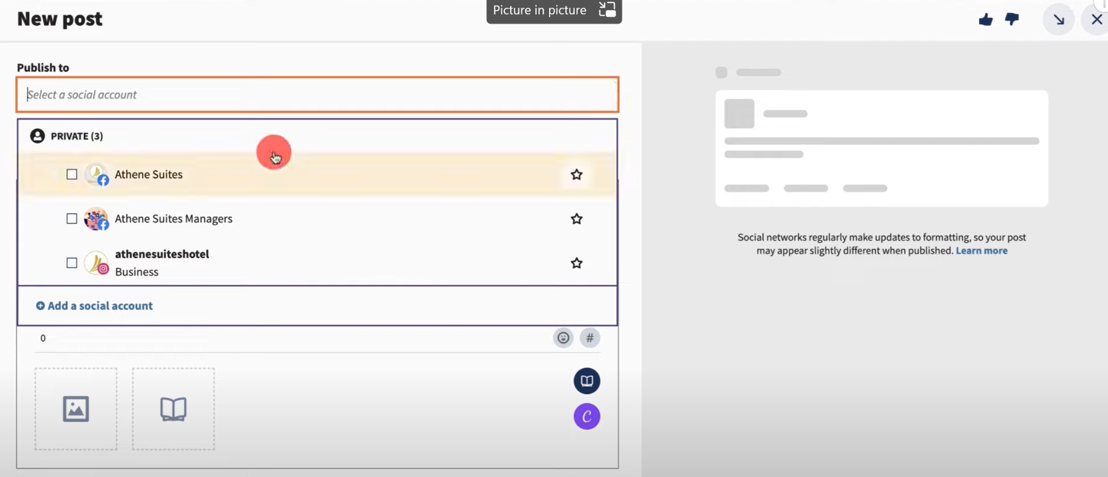

Slide 14
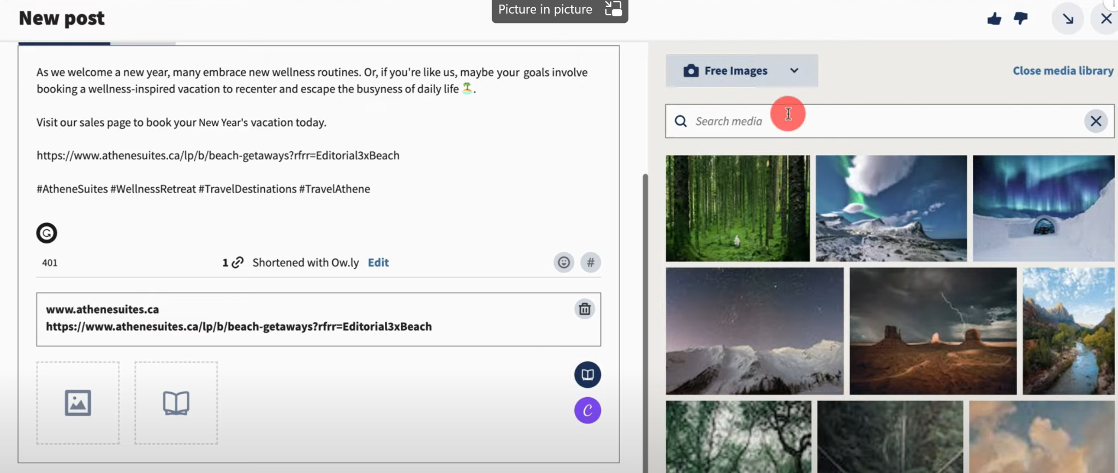

Slide 16
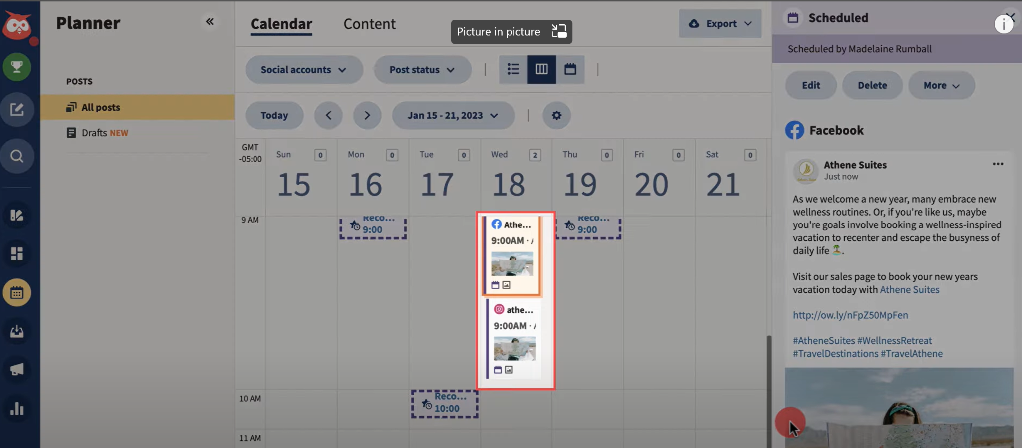

Slide 17
Questions

